Slide 1
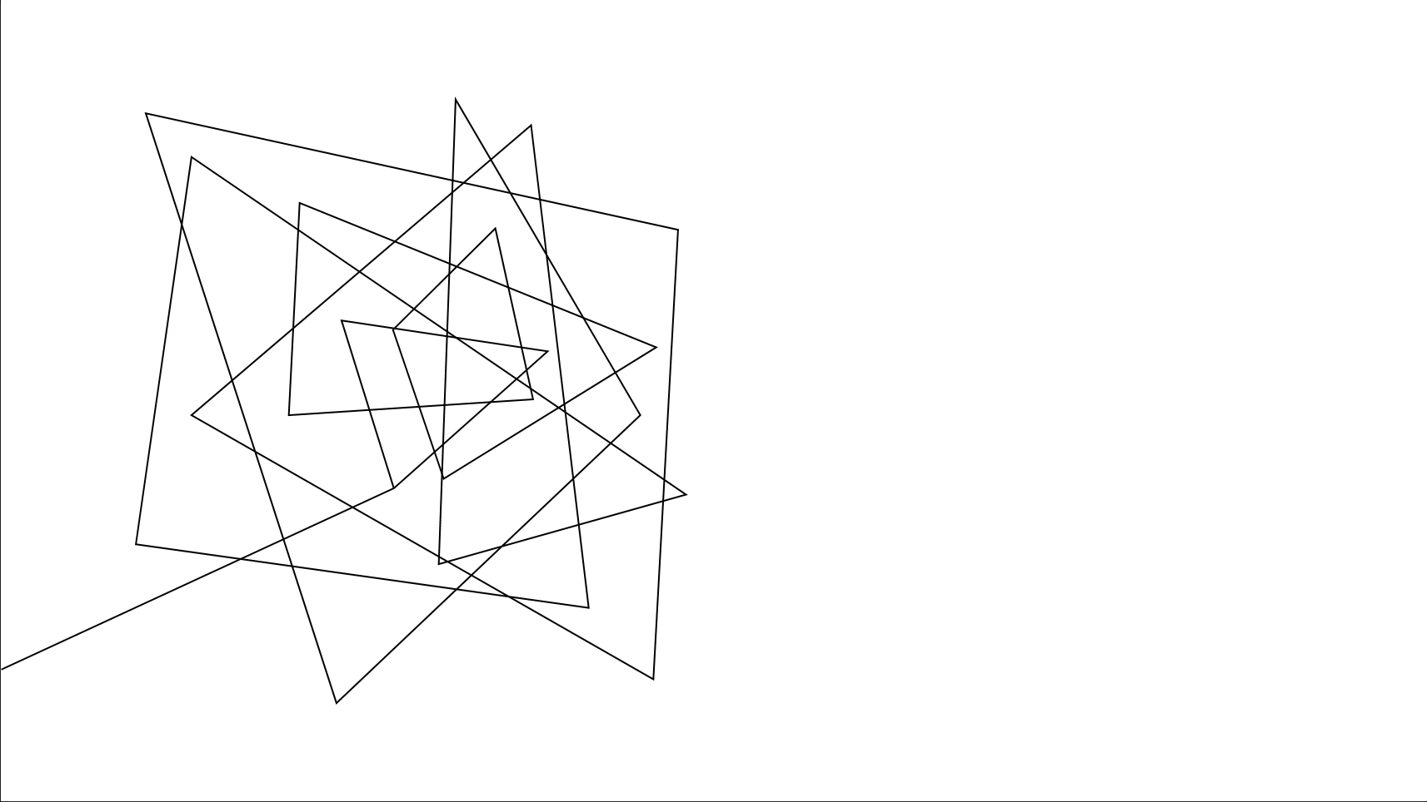
Dr. Pill
Automatic Pill Dispenser

Slide 2





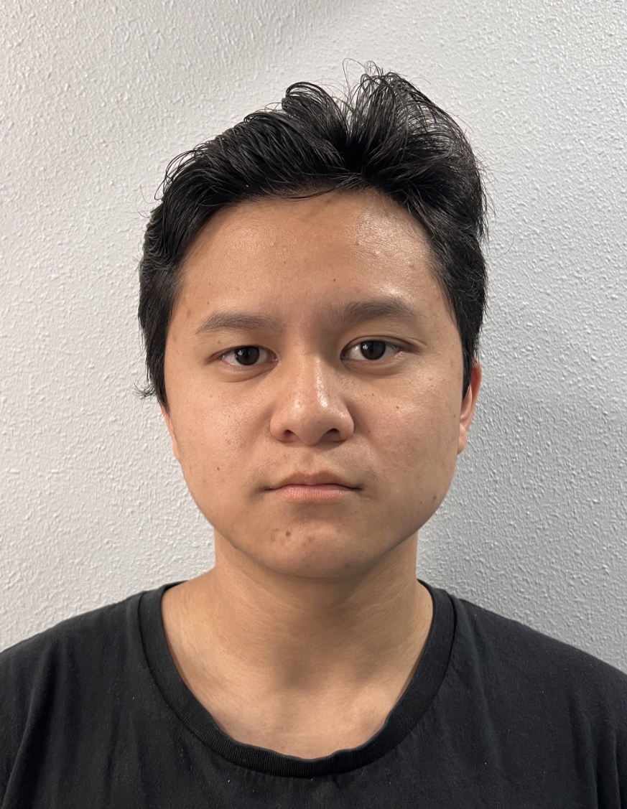
Team & Roles
Jonathan Cerniaz
Jehmel
Espiritu
Jeremy Espiritu
Joseph Guzman
Afzal
Hakim
Lee Roger
Ordinario
Power Supply & Regulation
Software Development of Interface
Software Development of Interface
System prototyping and calibration
Log tracking and Security
Pill Storage System and Organization

Slide 3

EXECUTIVE SUMMARY
Dr. Pill is an automatic pill dispenser that simplifies medication management. Our device aims to facilitate the process by freeing up more time for doctors and allowing patients to take their medication accurately by eliminating the common issue of medication errors and missed dosages.
Designated for pharmacies, nursing homes, personal households.
Dr. Pill

Slide 4

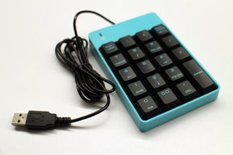
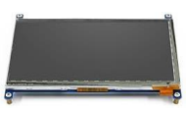


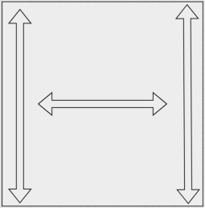
Technical Details
Hardware
Software
XAMPP Integration - MySQL Database - Apache Server
User Interface - Secure login system and permission-based actions
- Tracks and logs interactions for monitoring
- Guidance prompts for assistance if denied access
Log Tracking - Staff (Manage inventory, add/remove patient records, view logs) - Patients (Retrieve medication and view personal logs)
Optimizations: - Addition of MySQL Database and Apache Server
Dispense Mechanism
Refill (continuous)
On-demand (specific number of dosage)
Pill Verification
Identify pill characteristics (color, size, shape, markings)
Grid System
Motorized pill retrieval, compact design
Space-efficient storage layout
Power Consumption
~63 W Total Power
Raspberry Pi, STM32, motors, LCD display, sensors, pin pad, fingerprint scanner, facial recognition
Changes:
TM4C123GH6PM to STM32 microcontroller
Stepper motors to Servo motors
Dr. Pill
Dr. Pill

Slide 5
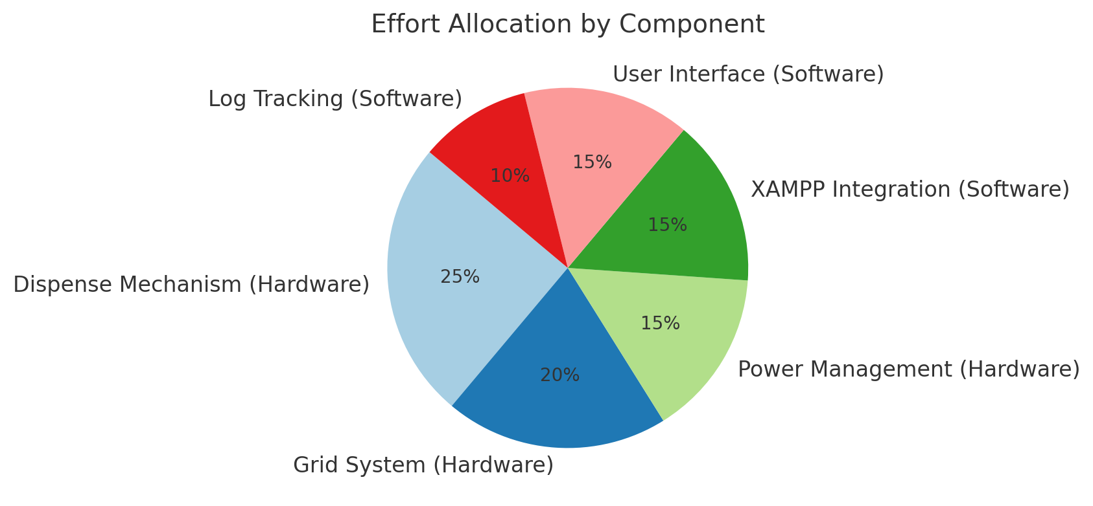
Technical DEPTH

Slide 6
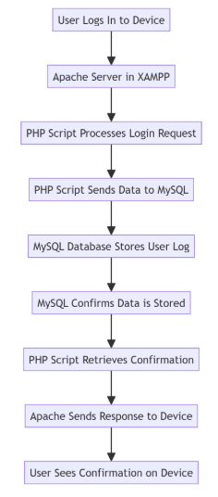
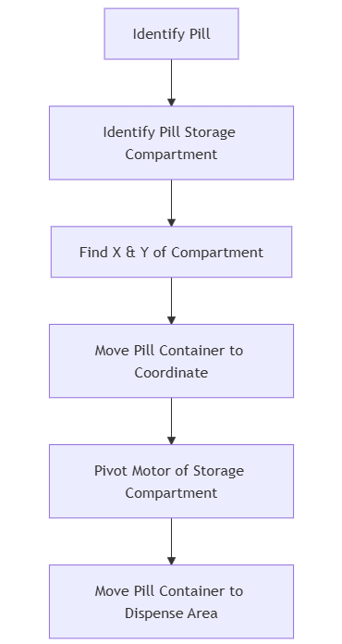
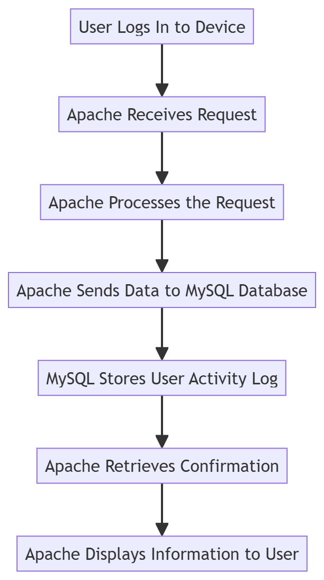
Dispensing + MySQL DiagraM

Slide 7
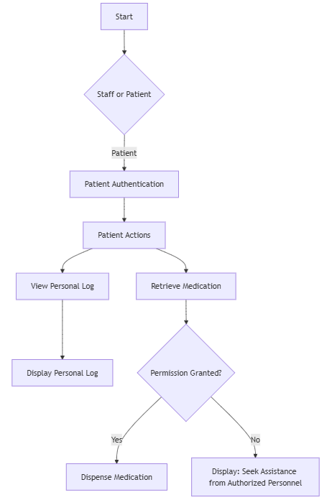
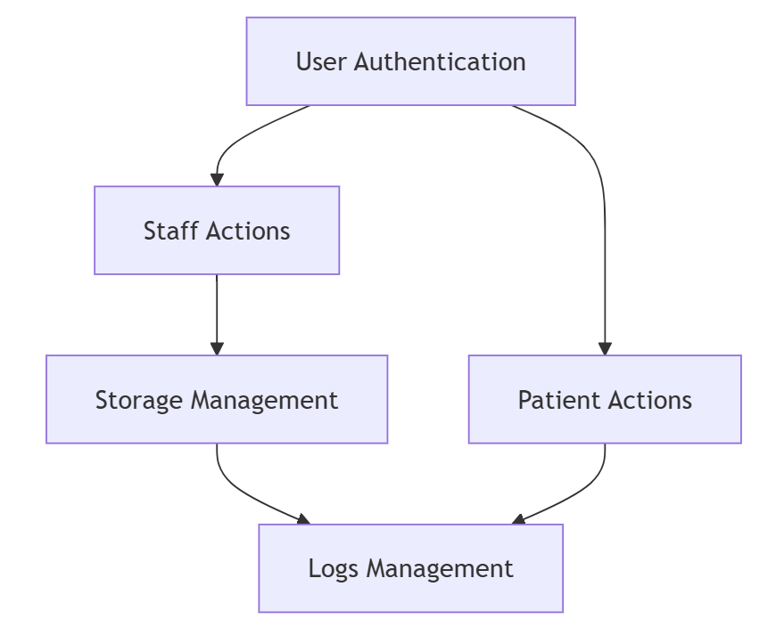
Authentication + Patient SIde

Slide 8
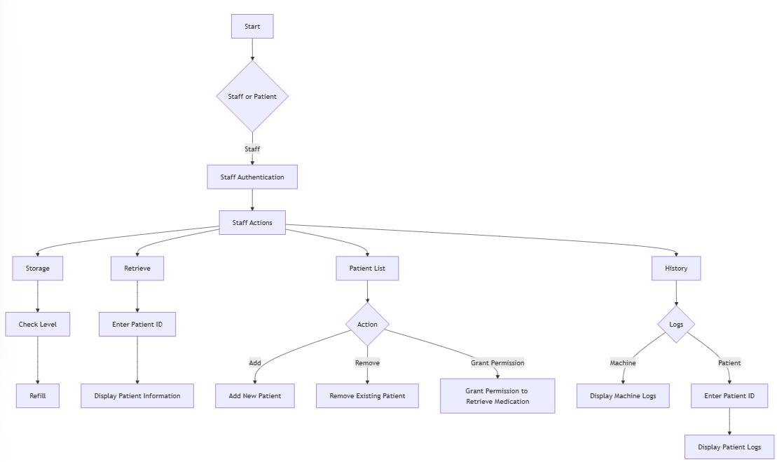
Authentication Staff SIde

Slide 9
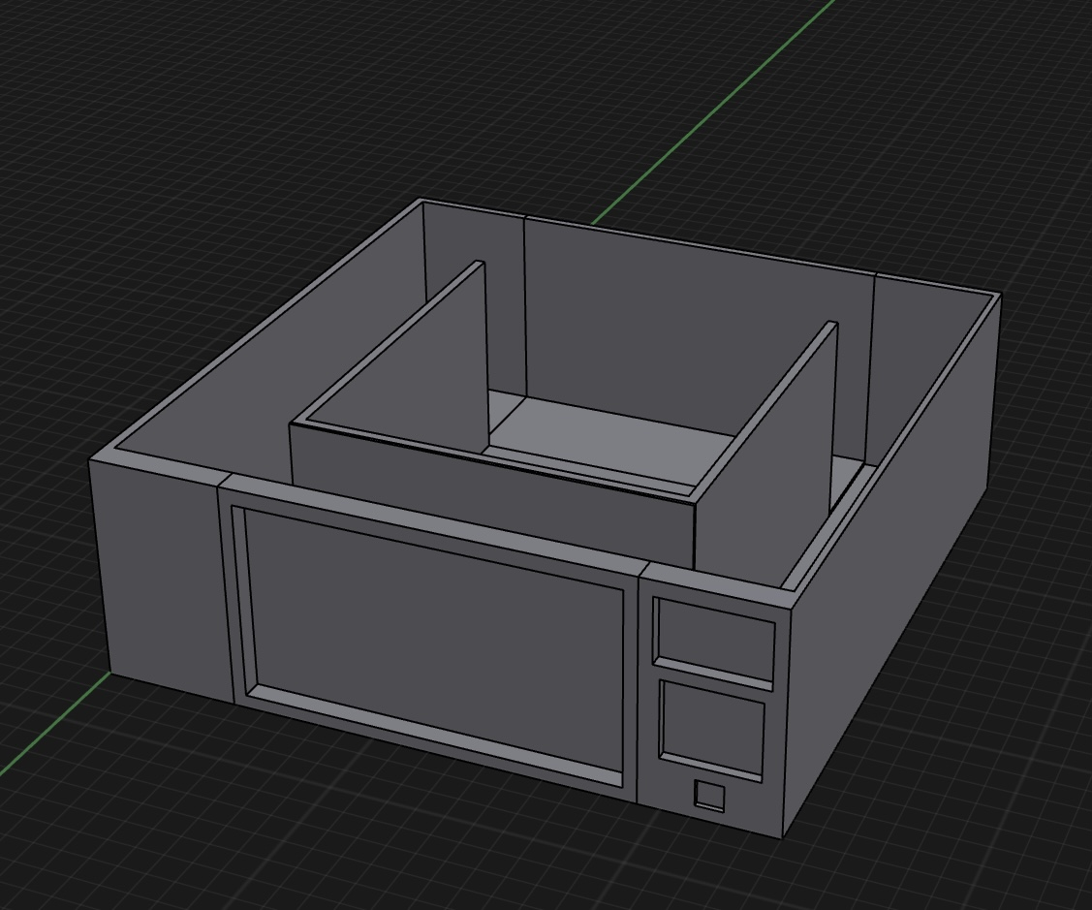
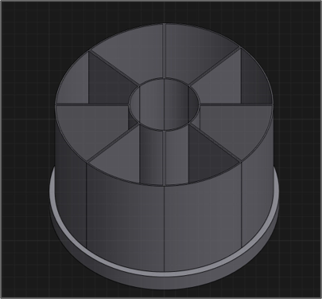
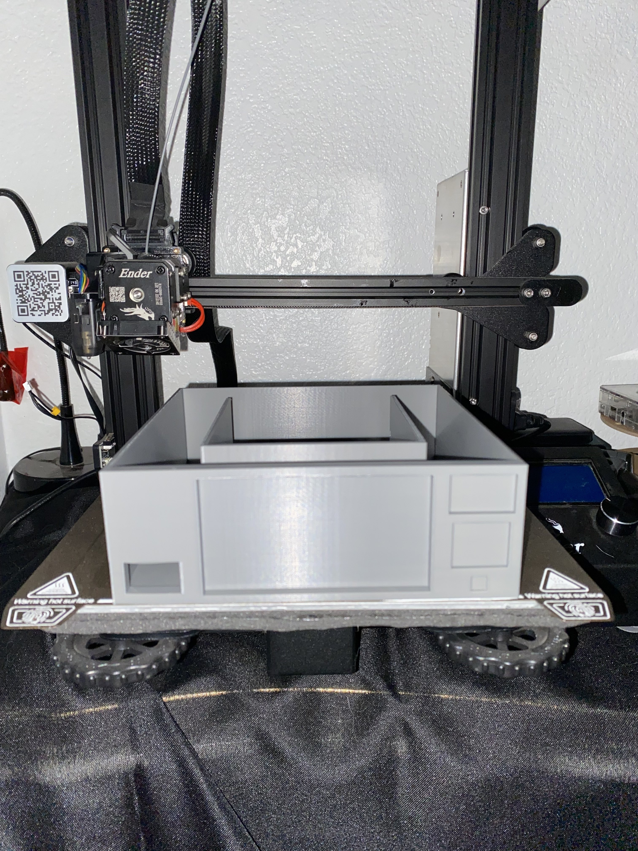
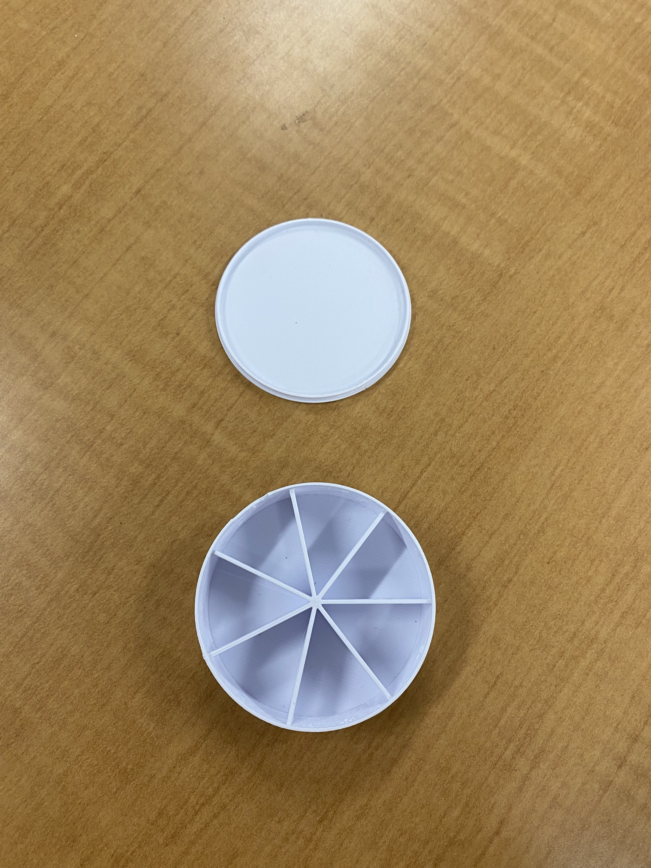
What was Prototyped?
Dr. Pill Layout Design
Enclosure Mockup
Storage Compartments
Dispense Mechanism
Motor Mounts
LCD Housing
Authenticator Housing
Prescription Bottle Holder
Dr. Pill
Dr. Pill

Slide 10
Challenges And Solutions
Challenges
Layout design
Concern of warping due to weight
Space management
3D Printing and Finish quality
"Spaghetti Print"
Rough and Jagged Edges
Limited Printing Space
Time and efficiency
Complex prints taking a significant amount of time
Solutions
Support structures for design
Taking measurements for amount of clearance needed
Adjustment to temperature of nozzle and printing bed
Create chamfers (bevel) or fillets (rounded edge) on corners instead of sharp 90° angles
Splitting design into multiple prints
Dr. Pill
Dr. Pill

Slide 11
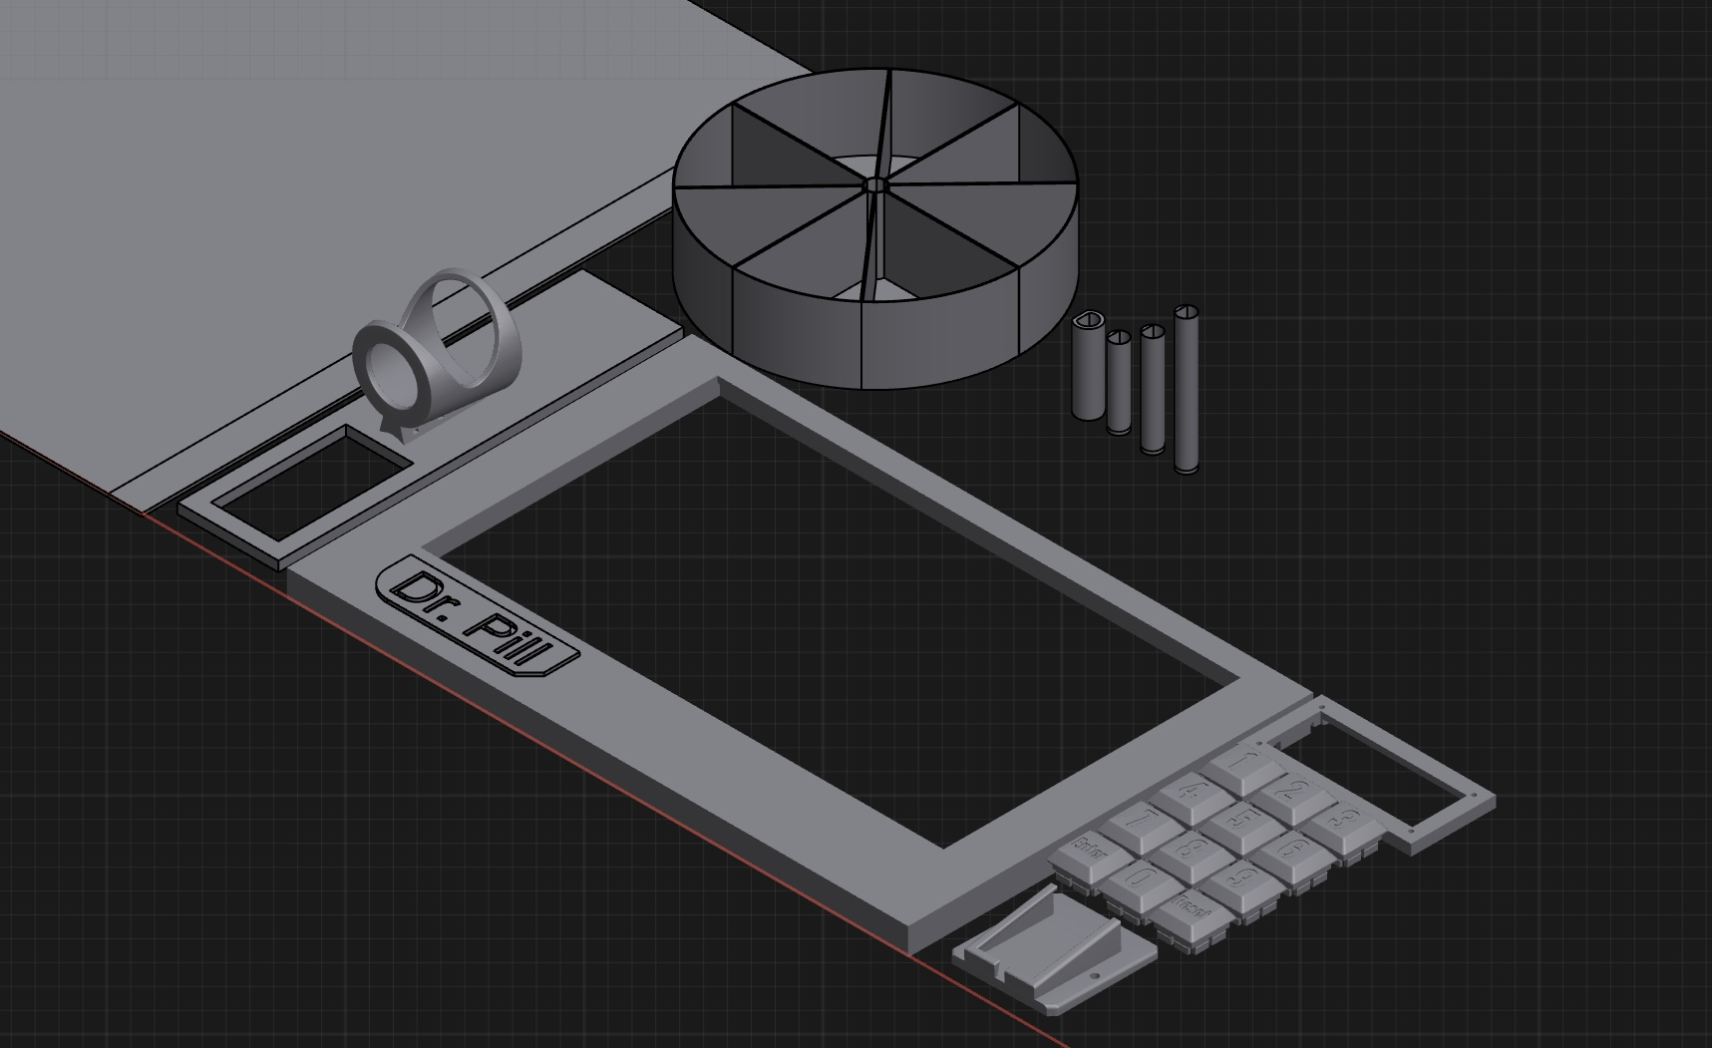
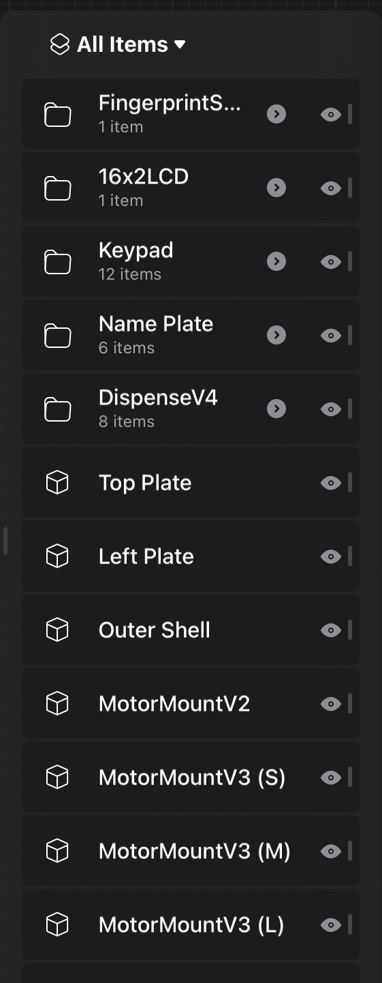
Benefits
Measurements
Helps with accurate scaling and proportions
Organization and Placement
Makes future revisions easier to track and implement
Pre-development Testing
Identify design flaws and validates functionality
Dr. Pill
Dr. Pill

Slide 12





Ethical Considerations & RESPONSIBILITIES
Patient Education & Accessibility:
Training, elderly users' technology adaptation, and intuitive design
Data Privacy & Security:
Protection of records and information, restricted access, and secure data storage
Safety & Reliability:
Fail-safe mechanisms, preventing cross-contamination, system monitoring, and emergency alerts
Dr. Pill
Dr. Pill

Slide 13
First Prototype Design
Sep 27, 2024
2024
2024
Today
TIMELINE
 | 24’ Aug | 24’ Sep | 24’ Oct | 24’ Nov | 24’ Dec | 25’ Jan | 25’ Feb | 25’ Mar | 25’ Apr | 25’ May
Designing & Planning
Final Design Adjustments
3D Design / Build Device
Hardware Development
Motor Testing
Display Testing
Software Development
Display Software
MySQL & Apache
Integration & Testing
Project Completion
Aug 26 – Dec 18
Nov 19 – Dec 1
Nov 19
Dec 18
Oct 1 – Mar 1
Nov 19
Jan 1
Nov 26
Dec 18
Oct 7 – Mar 1
Nov 19
Feb 1
Nov 10
Dec 18
Feb 1 – May 9
May 9
Dr. Pill

Slide 14
First Prototype Design
Sep 27, 2024
2024
2024
Today
TIMELINE Spring 2025
Milestone | 1 Jan | 1 Feb | 1 Mar | 1 Apr | 1 May
Phase 1
MySQL + Apache + XAMPP Setup
Finalize Dispensing Mechanism Design
Setup Motors with Rasp pi
Test Initial Dispensing Mechanism Prototype
Phase 2
Security Device Initialization
Create an App For User Interface
Test Display UI
Phase 3
Combine MySQL & User Interface
Setup Object Recognition
Combine Object Recognition Device & MySQL
Test MySQL logs and Authentication
Jan 13 – jan 31
Jan 13 – Jan 19
Jan 13 – Jan 19
Jan 19- Jan 26
Jan 26- Jan 31
Feb 1 – feb 28
Feb 1 – Feb 14
Feb 1 – Feb 23
Feb 23 – Feb 28
Mar 1 – Mar 30
Mar 1 – Mar 16
Mar 1 – Mar 16
Mar 16 – Mar 22
Mar 23 – Mar 30
Dr. Pill

Slide 15
First Prototype Design
Sep 27, 2024
2024
2024
Today
TIMELINE Spring 2025
Milestone | 1’ Jan | 1’ Feb | 1’ Mar | 1’ Apr | 1' May
Phase 4
Comprehensive testing & Debugging
Optimization and Final add-ons
Final Testing & Validation
Mar 31 - may 9
Mar 31 – April 26
Mar 31 – Apr 26
Apr 27 – May 9
Dr. Pill

Slide 16
First Prototype Design
Sep 27, 2024
2024
2024
Today
Project plan
Milestone | Start Date | End Date | Dependencies
MySQL + Apache + XAMPP Setup | Jan 13 | Jan 19 | None
Finalize Dispensing Mechanism Design | Jan 13 | Jan 19 | None
Setup Motors with Rasp pi | Jan 19 | Jan 26 | Dispensing Mechanism Design
Test Initial Prototype | Jan 26 | Jan 31 | Dispensing Mechanism Design
Security Device (Fingerprint + Facial Recognition) | Feb 1 | Feb 14 | MySQL setup
Dr. Pill

Slide 17
First Prototype Design
Sep 27, 2024
2024
2024
Today
Project plan
Milestone | Start Date | End Date | Dependencies
Creation of App for UI | Feb 1 | Feb 23 | MySQL setup
Setup Touchscreen Display UI | Feb 16 | Feb 23 | MySQL + Peripheral Designs
Motor Setup for Dispensing | Feb 17 | Feb 23 | Dispensing Mechanism + Raspberry Pi
Test Display UI and Security Device | Feb 23 | Feb 28 | MySQL and Display UI
Combine MySQL and UI | Mar 1 | Mar 16 | MySQL setup and Display UI
Dr. Pill

Slide 18
First Prototype Design
Sep 27, 2024
2024
2024
Today
Project plan
Milestone | Start Date | End Date | Dependencies
Object Recognition Integration | Mar 1 | Mar 16 | Raspberry Pi + Display UI
Combine Object Recognition and MySQL | Mar 16 | Mar 22 | Object Recognition setup + MySQL setup
Test MySQL log tracking | Mar 23 | Mar 30 | Object Recognition setup + MySQL setup + Raspberry pi + Display UI
Comprehensive Testing | Mar 31 | Apr 26 | Complete System
Dr. Pill

Slide 19
First Prototype Design
Sep 27, 2024
2024
2024
Today
Project plan
Milestone | Start Date | End Date | Dependencies
Optimization + Final add-ons | Mar 31 | Apr 26 | Complete System
Final Testing & Validation | Apr 27 | May 9 | Complete System
Dr. Pill

Slide 20
REFERENCES
Alam, Md Tausif, et al. “FDA-Approved Natural Polymers for Fast Dissolving Tablets.” Journal of Pharmaceutics, U.S. National Library of Medicine, https://www.ncbi.nlm.nih.gov/pmc/articles/PMC4590815/
Alei. “Pill Size Chart.” AIPAK, 9 Apr. 2024, www.icapsulepack.com/pill-size-chart/.
Budibase. “How to Build a SQL GUI in Minutes | Budibase.” Budibase Blog, https://budibase.com/blog/tutorials/sql-gui/
Charlesworth, Christina J, et al. “Polypharmacy Among Adults Aged 65 Years and Older in the United States: 1988-2010.” The Journals of Gerontology. Series A, Biological Sciences and Medical Sciences, U.S. National Library of Medicine, www.ncbi.nlm.nih.gov/pmc/articles/PMC4573668/.
Craig M. Hales, M.D., M.P.H., Jennifer Servais, B.Sc., Crescent B. Martin, M.P.H., M.A., and Dafna Kohen, Ph.D., M.Sc., “Products - Data Briefs - Number 347 - August 2019.” Centers for Disease Control and Prevention, 14 Aug. 2019, https://www.cdc.gov/nchs/products/databriefs/db347.htm#:~:text=Among%20U.S.%20adults%20aged%2060,proton%20pump%20inhibitors%20(16.9%25/
Embedded._.programmer. "Raspberry pi setup with 7 inch touch screen." YouTube, 22 Oct. 2022, www.youtube.com/watch?v=hVn4-GMF7Eg.
Ferro Uriguen, Alexander, et al. “Determination of the Cross-Contamination and Validation of the Cleaning Process for an Automated Personalised Dosing System.” European Journal of Hospital Pharmacy : Science and Practice, U.S. National Library of Medicine, www.ncbi.nlm.nih.gov/pmc/articles/PMC9047934/.
Formlabs, “The Essential Guide to Food Safe 3D Printing.” Formlabs, formlabs.com/blog/guide-to-food-safe-3d-printing/.
Gaikwad, Manjiri. "Running SQL Server on Raspberry Pi Using Docker | A 101 Guide." Hevo Data, 31 July 2022, https://hevodata.com/learn/sql-server-on-raspberry-pi/.
Dr. Pill
Dr. Pill

Slide 21
REFERENCES
"How to Control Servo Motors with a Raspberry Pi." Digi-Key Electronics, www.digikey.com/en/maker/tutorials/2021/how-to-control-servo-motors-with-a-raspberry-pi.
"How to Setup Raspberry Pi for Beginners." YouTube, uploaded by Bytesized_Raspberry_Pi, 23 Dec. 2021, youtu.be/N_lbMR6_EBA.
J. Mark Ruscin, Sunny A. Linnebur, “Aging and Medications - Aging and Medications.” Merck Manual Consumer Version,
www.merckmanuals.com/home/older-people%E2%80%99s-health-issues/aging-and-medications/aging-and-medications.
"Pharmaceutical Packaging Design Tips for Improved Safety." Luminite, blog.luminite.com/blog/pharmaceutical-packaging-design-tips-for-improved-safety.
“Pill Counting Scales.” DSCBalances, www.dscbalances.com/collections/pill-counting-scales.​
Ranjit’s Embedded Solutions, “Arduino-based Conveyor Belt Using DC Motor with RPM Control And Object Counting”, YouTube, www.youtube.com/watch?v=VHAqJ9a7SqI.
Rosemont Pharma, “Rosemont: Information For Patients On The Dangers Of Tablet Crushing.”, 14 Oct. 2023, www.rosemontpharma.com/tablet-crushing/.
Running SQL Server on Raspberry Pi Using Docker | A 101 Guide." YouTube, uploaded by Hevo Data, 31 July 2022, https://youtu.be/uS9VvnJWoxs.
UI Bakery. “How to Build a Custom SQL Database GUI | UI Bakery.” YouTube, 20 Oct. 2020, https://www.youtube.com/watch?v=FGDwVagO1XI.
Dr. Pill

Slide 22
REFERENCES
Wang, Nathan, “What Is PLA Plastic? Benefits, Uses, and Safety of PLA Material!” Onenice Internaional Co., Ltd., 30 July 2024, www.geckohaha.com/what-is-pla-plastic/.
YouTube: Best Automatic Pill Dispensers [November 2021], www.youtube.com/watch?v=ffu1d6DnqjQ.
YouTube: Count Right Pill Counter (J1245n) - Inventory, www.youtube.com/watch?v=l1ECQJ63jCg.
YouTube: Electronic Tablet Counter: RX 4 Capsule Counter Machine by RX Count, www.youtube.com/watch?v=mO_NhPjw8f0.
Dr. Pill

Slide 23

Thank You
Dr. Pill

